Slide 1

PDF Summarization And Other Operators.
By:Nandhinee

Slide 2

Domain:
AI and ML:
The integration of Artificial Intelligence (AI) and Machine Learning (ML) into this mini project is crucial for transforming traditional document processing into an intelligent, automated system. Unlike basic rule-based approaches, AI and ML models have the ability to understand, interpret, and generate human-like language, which makes them ideal for tasks like summarisation and question answering.

Slide 3

What is Pdf summarization?
PDF summarization refers to the process of automatically generating a shorter version (summary) of the content found in a PDF file, while preserving its key ideas and main points. It falls under the broader category of text summarization in Natural Language Processing.

Slide 4
Models Used:
Text-to-Speech
Text Summarization
Question-Answering
The TTS feature converts text from selected PDF pages into audio, making the content accessible for users who are visually impaired or those who prefer an auditory experience.
The summarization functionality uses a pre-trained model from Hugging Face’s NLP repository to generate concise summaries of the document. By condensing large amounts of text, this feature provides a quick overview of key points, saving users the time and effort of reading lengthy documents.
Users can ask specific questions about content within a designated range of pages, and the model processes the text within this range to generate relevant answers.
Our PDF Reader leverages advanced AI technologies to provide a more accessible and interactive experience. Using Gradio for an intuitive interface, users can upload PDFs and interact with their contents through these three key features, making document interaction more efficient and accessible for diverse audiences.

Slide 5
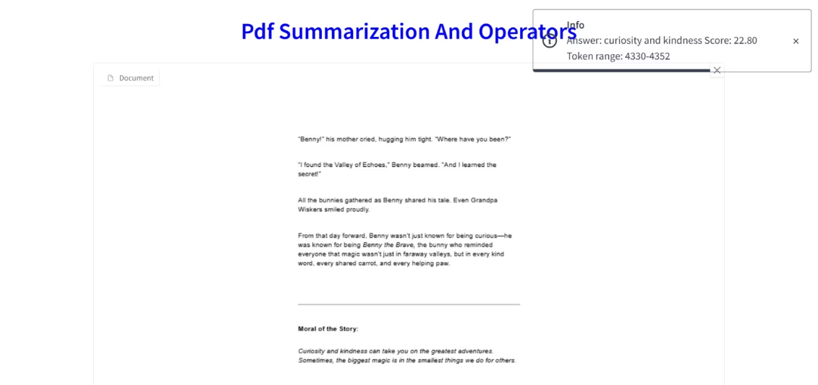
Accuracy:
Question answering model has a output feature called as score, which will tell the closeness of answer to the actual context.

Slide 6


